Slide 1

Sustainable Development Goal 8
Decent Work and Economic Growth
Promote sustained, inclusive and sustainable economic growth, full and productive employment and decent work for all.South Africa
South Africa faces significant challenges with unemployment, which stands at over 30%. This presentation outlines a project to address this issue and align with the United Nations' Sustainable Development Goal 8 (SDG8) - Decent Work and Economic Growth. The project aims to leverage data insights and innovative solutions to create sustainable jobs and improve economic opportunities for all South Africans.
by Nelisiwe Gama
South Africa
nelisiwegama2@gmail.com

Slide 2

Problem Definition and Significance
1
High Unemployment Rates
2
Lack of Opportunity
South Africa's unemployment rate is over 30%, with youth unemployment exceeding 50%. This has significant social and economic consequences.
Many South Africans, especially in underserved communities, lack access to jobs, skills training, and economic resources.
3
Alignment with SDG8
Addressing unemployment is crucial to achieving SDG8 - Decent Work and Economic Growth, a key United Nations sustainable development goal.

Slide 3
Database Design and Schema
Data Sources
Key Entities
Analytical Capabilities
The database will integrate data from government labor statistics, job posting websites, and surveys of job seekers and employers.
The schema will include tables for job listings, job seeker profiles, training programs, and labor market analytics.
The database will power advanced analytics to identify skills gaps, match job seekers to opportunities, and recommend training programs.

Slide 4
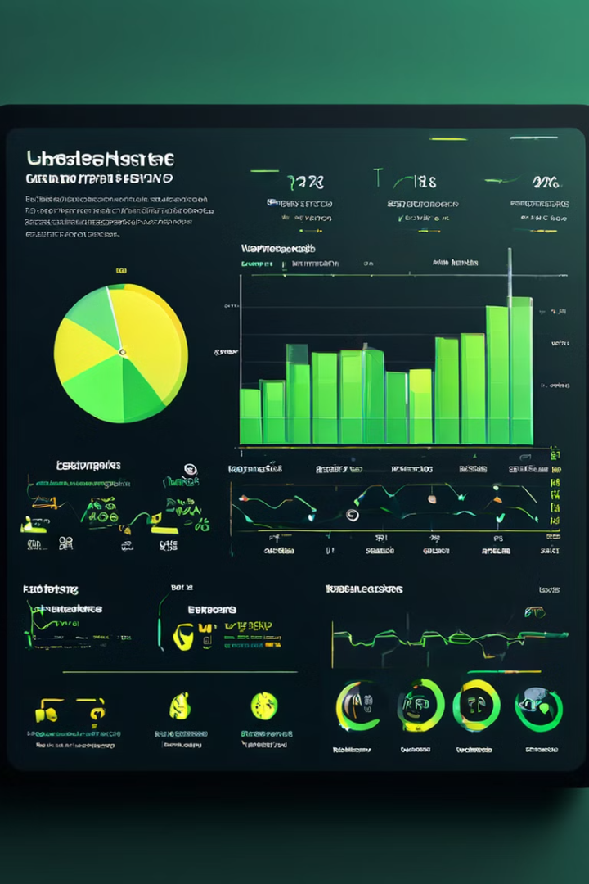
Data Analysis Insights
Unemployment Trends
1
Analyze historical unemployment data to identify patterns, seasonal fluctuations, and high-risk sectors.
Skills Gaps
2
Identify in-demand skills and job requirements that are not being met by the current labor pool.
Training Effectiveness
3
Evaluate the impact of training programs in improving employment outcomes and addressing skills shortages.

Slide 5
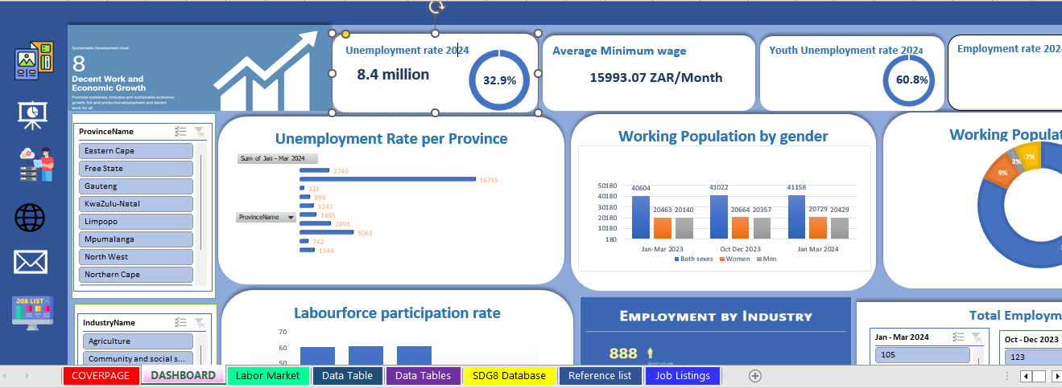



Excel Dashboard Demonstration
Dynamic Visualizations
Data-Driven Insights
User-Friendly Interface
The dashboard features interactive charts, graphs, and tables to present key insights at a glance.
The dashboard leverages the project's database to provide data-driven recommendations and forecasts.
The dashboard is designed with a clean, intuitive layout to enable easy navigation and decision-making.

Slide 6
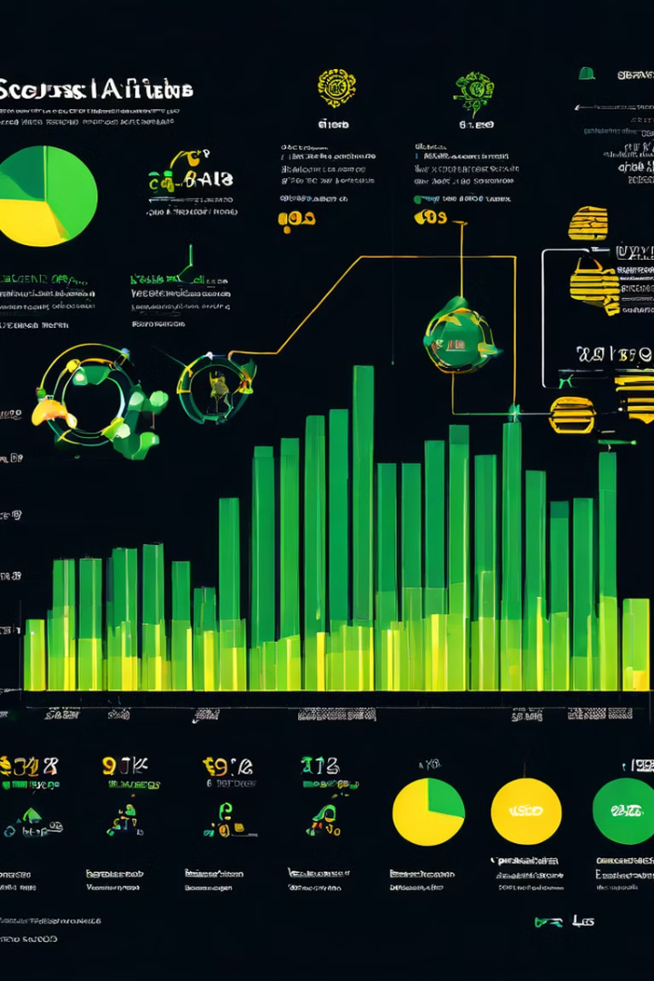
Target Market and Opportunity
Underserved Communities
High-Growth Sectors
The analysis will identify industries with strong growth potential and skill shortages to target for job placement and training.
The project will prioritize job creation and skills development in disadvantaged communities with high unemployment.
Alignment with SDG8
Scalable Impact
The data-driven approach and innovative solutions can be replicated and scaled to drive widespread economic and social change.
The project's focus on decent work and economic empowerment aligns with the United Nations' Sustainable Development Goal 8.

Slide 7
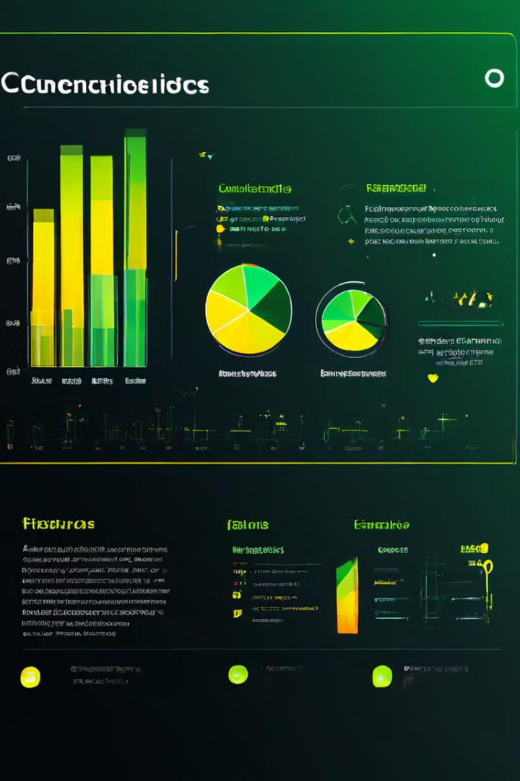




Competitive Landscape and Differentiation
Data-Driven Insights
The project's advanced data analytics and dashboard provide unparalleled labor market insights to guide decision-making.
Customized Training
The training programs are tailored to address specific skills gaps and employer needs in high-potential industries.
Holistic Support
The project offers a comprehensive suite of services, including job placement, mentorship, and post-employment support.

Slide 8
Thank you

